Slide 1
Project Proposal Project Title: Online Hotel Reservation System. Course Code & Title: CSE-0318 Software Engineering Lab. Submitted By: Kh Md Shahnayas, ID:UG02-49-18-008. Batch:49 Semester: Summer 2021

Slide 2

Online Hotel Reservation System: Online hotel reservation system is basically a website that will allow a user to search and reserve a hotel room or cancel his reservation over the internet at any time.
Travellers can compare prices and facilities at different hotels through this website.

Slide 3

Introduction
This works denotes online hotel reservation system.
Online hotel reservation system works by processing secure online reservations made through a hotel’s website.
Nowadays hotels are using online hotel reservation system to grow their business and increase their bookings overtime.
With the ever expanding use of the internet and online travel booking sites for vacation planning, opportunities may exist for travel companies.

Slide 4

Advantages of online hotel reservation system:
#A user can reserve rooms with their own room preferences at any time.
#Dynamic price search for rooms.
#User's review on the website based on the quality of rooms will help other user's to take their decision.
#It is helpful for making last minute travel arrangements because hotels may drop the price of a room if some rooms are still available.
#The user will enjoy many discount offers on bookings.

Slide 5

Goals of this project-
#To develop and design an website on online hotel reservation system which will help its's user to search & book hotel rooms on one click.
#The website must be user friendly, easy to access and attractive.
#All the information associated with rooms like is it single bed or double bed room, does it have Sofa, TV, Balcony, AC, Wi-Fi facility etc. must be available on this website.
#This website should be capable to protect the privacy and financial information of its user.

Slide 6

Features of online hotel reservation system:
*Under the Home page there will be features like Room & Facilities, Online Reservation, Admin etc.
*There will be a user's Review option under the Room & Facilities.
*An user can view features like Room & Facilities, Online Reservation, Review etc.
*The admin section is for administrators of this website who will update important things like Room Category, Bookings, Add Manager etc.
*First of all the admin have to Log In using his Username or Email and password to update features and important informations .

Slide 7

*Brief overview of the design & components:
Microsoft Visual Studio & Notepad++ will be used for developing this project.
In the Back end I will use PHP, MySQL .
#PHP will be used to create dynamically generated web pages.
# I will use MySQL to create database.
I will use HTML, CSS, Bootstrap in the front end:
# I will use HTML to create and save web document.
#CSS will be used to Create attractive Layout.
#I will use Bootstrap to create responsive design mobile friendly site.

Slide 8
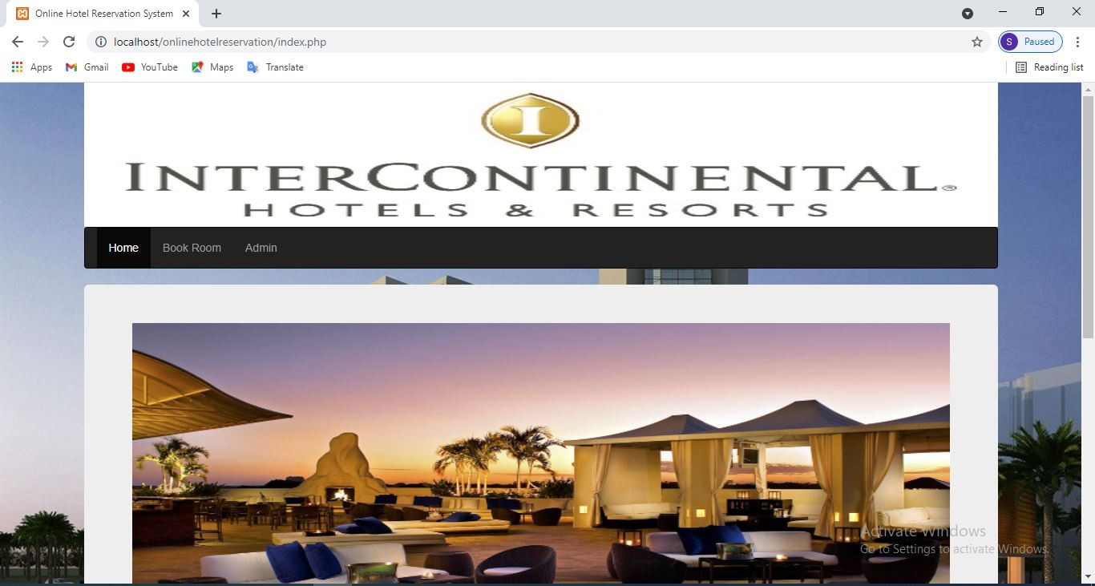
Homepage

Slide 9
Homepage:
#In our homepage there are a lot of stuff like about us, contact us, developed by etc.
#About us section describe the purpose of our website.
#This about us section tell us what is the purpose of an online hotel reservation system.
#Contact us contains the contact info of the hotel like physical address and email address of the hotel.
#Developed by section contains the information of website developer. Here I have mentioned the name and GitHub link of the website developer.

Slide 10
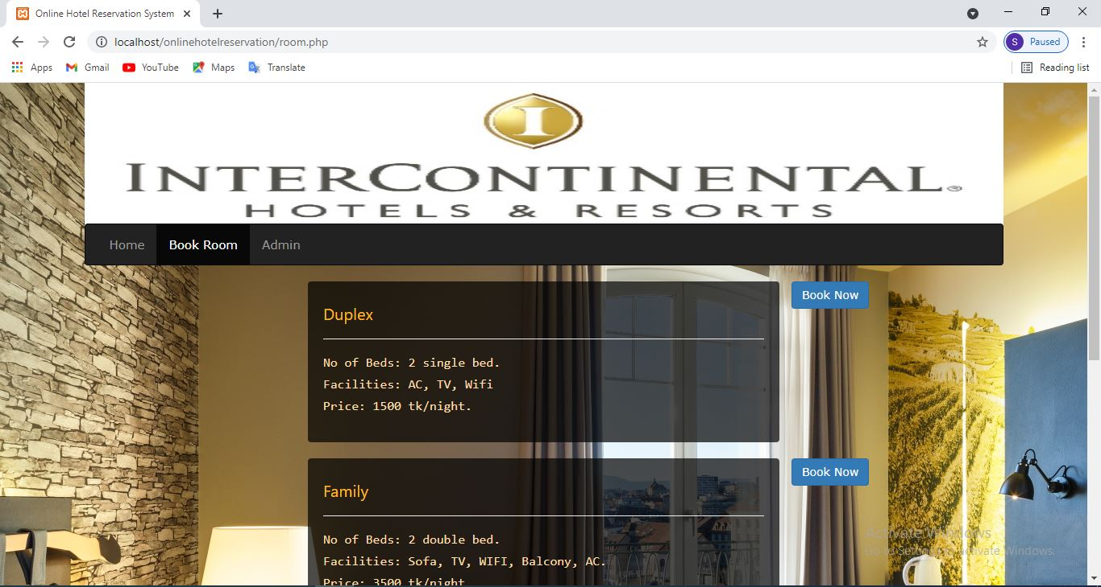
Book Room

Slide 11
Book Room:
A user will be able to book room from this page and all necessary information of a
room will be available in this page. All the information associated with rooms like is it
single bed or double bed, does it have Sofa, TV, Balcony, AC, Wi-Fi facility etc will be
available on this page. Room prices are also available on this page. A user can book
room by just clicking on the Book Now button. After clicking on book now button this
website will require some information of the user like name, phone number, Check In
date, Check Out Date to confirm the reservation. After filling those necessary
information the user have to click the Book Now button again and after clicking Book
Now button hotel reservation process will be completed.

Slide 12
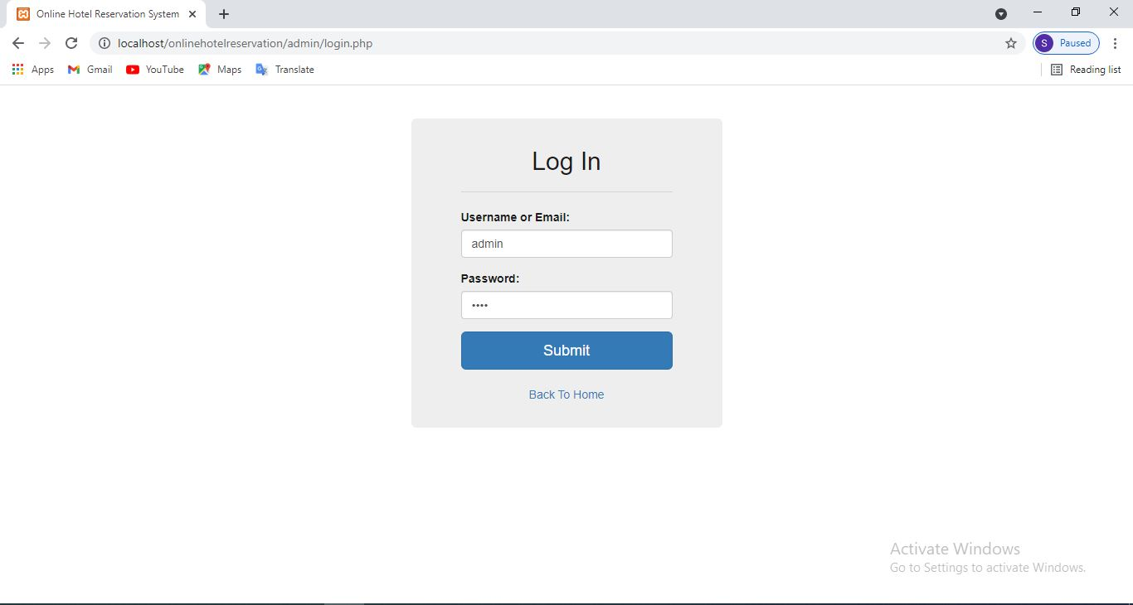
Log In Page

Slide 13
Log In Page:
#The function of Log In page: To enter into the admin panel first of all the admin have
to log in using username or email and password from the Log In page.

Slide 14

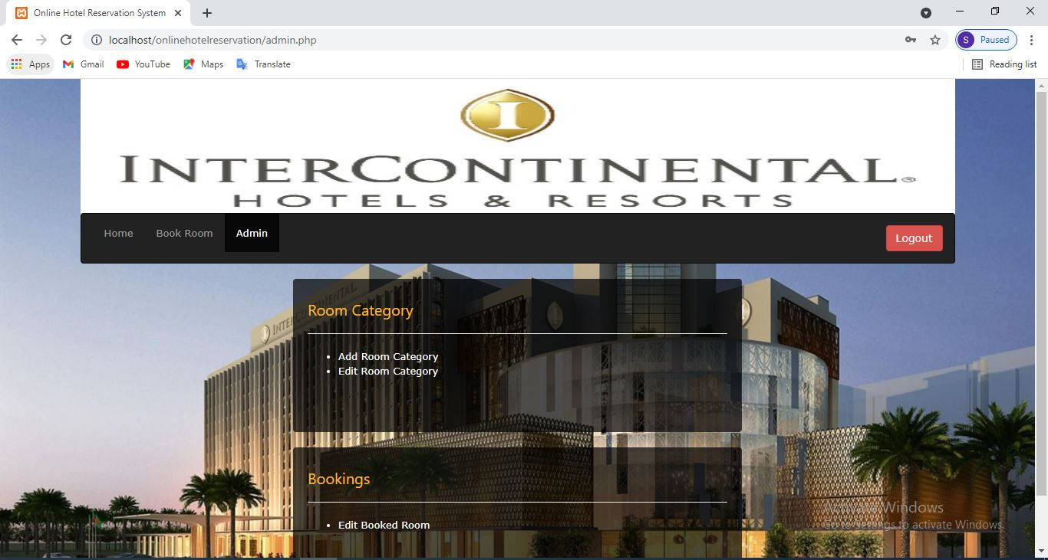
Amin Panel

Slide 15
Amin Panel:
#After login the Admin panel interface will be visible in-front of admin.
#The admin will manage things like adding or editing room category or editing booked rooms.
#The admin can delete any room category.
#The admin will be able to delete any bookings from Admin panel

Slide 16
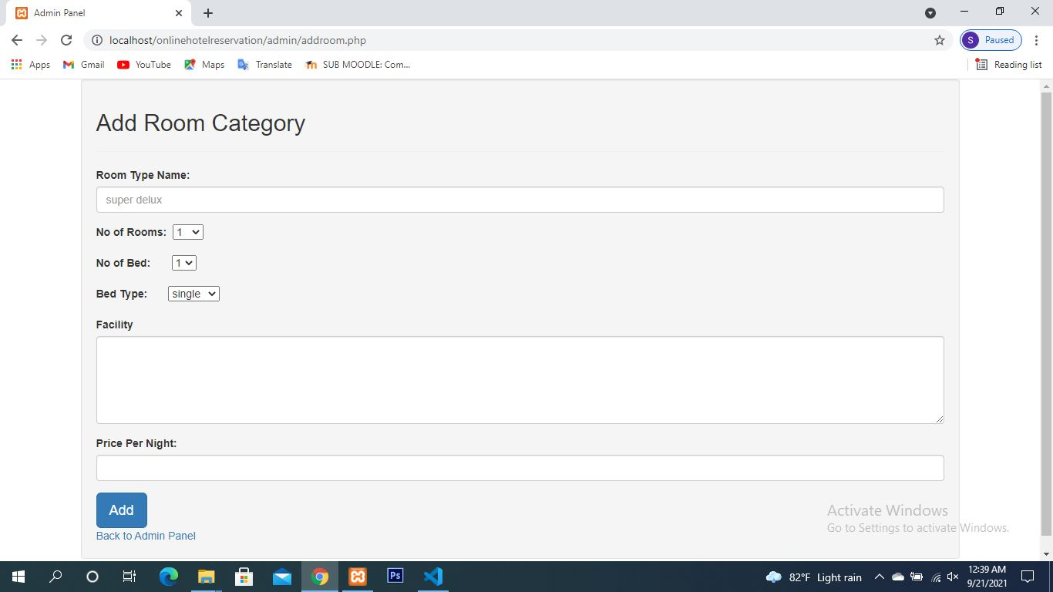
Add Room Category

Slide 17
Add Room Category: From this page the manager of this hotel who is also an admin of this website can add new types of room categories where all the necessary information of a room will be described briefly.
Necessary information of a room like Room Type Name, No of Rooms, No of Bed, Bed Type, Facility, Price Per Night etc. will be added from this page.

Slide 18
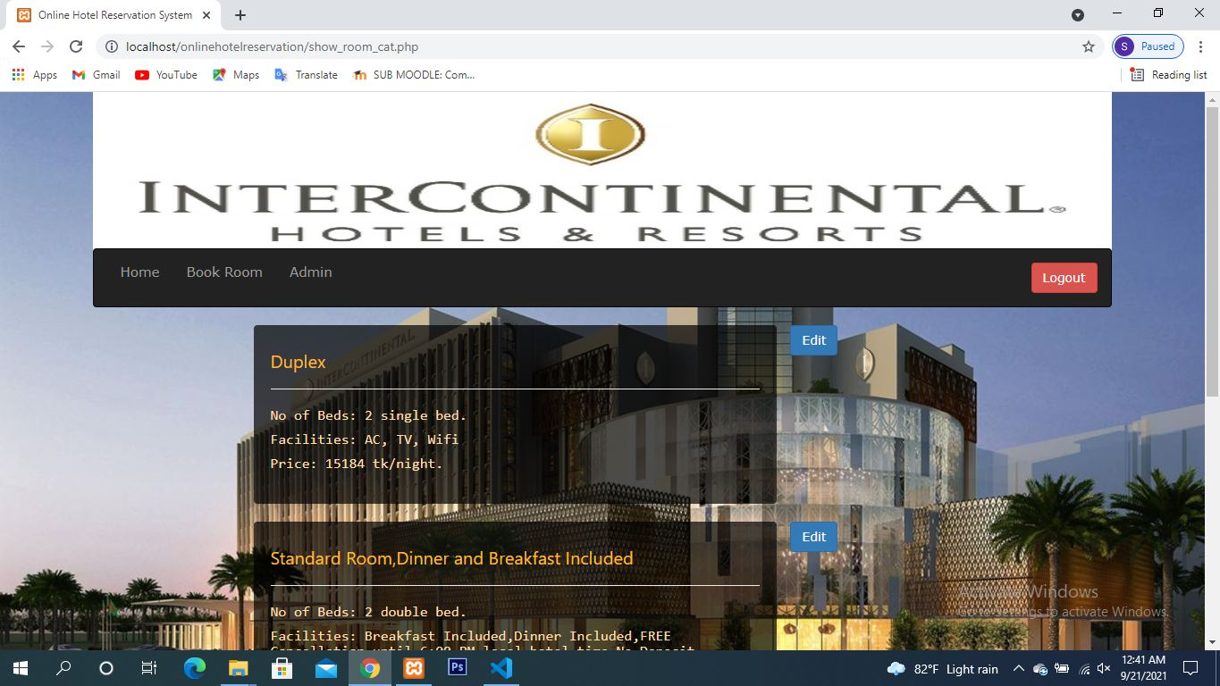
Edit Room Category

Slide 19
Edit Room Category:
From this page the admin can edit existing room categories and existing necessary informations of a room.
The admin also can edit Room Type Name, No of Rooms, No of Bed, Bed Type, Facility, Price Per Night etc.

Slide 20
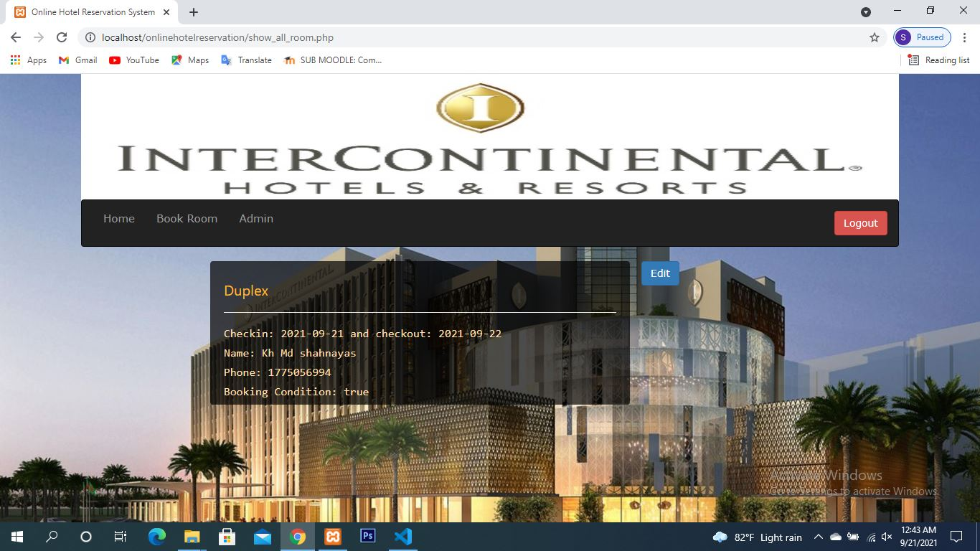
Edit Booked Room

Slide 21
Edit Booked Room:
Information of all the booked rooms will be available in this page.
The admin can view booked rooms information by clicking on this page.
The admin can edit informations of a booked room like Check In date, Check Out date, Full Name of a client, Phone Number of a client.

Slide 22
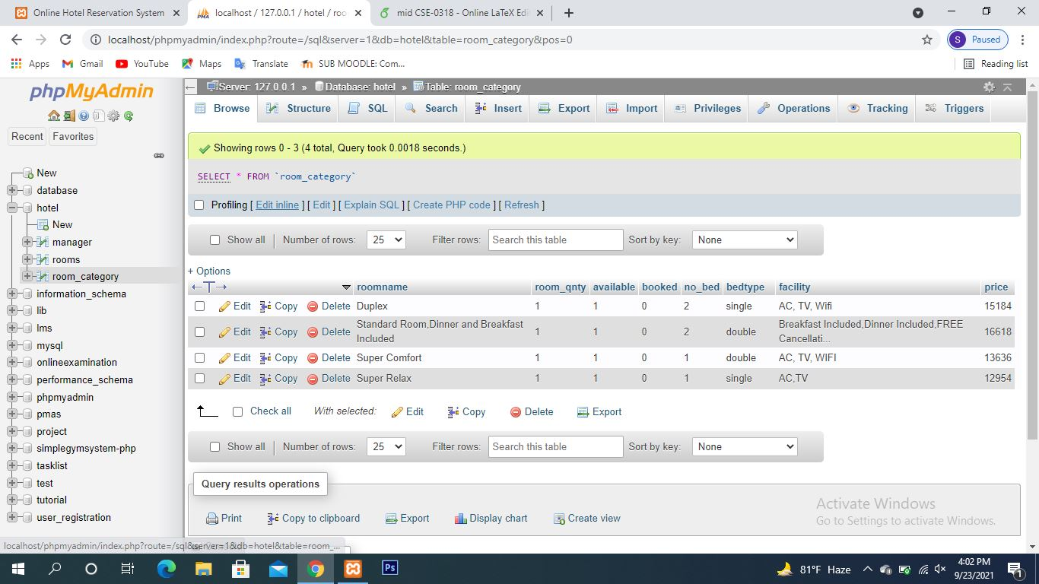
Database

Slide 23
Database: I have used mySQL to develop database.
The name of our database file is hotel. The file contain three different field like Manager, Rooms and Room category.

Slide 24
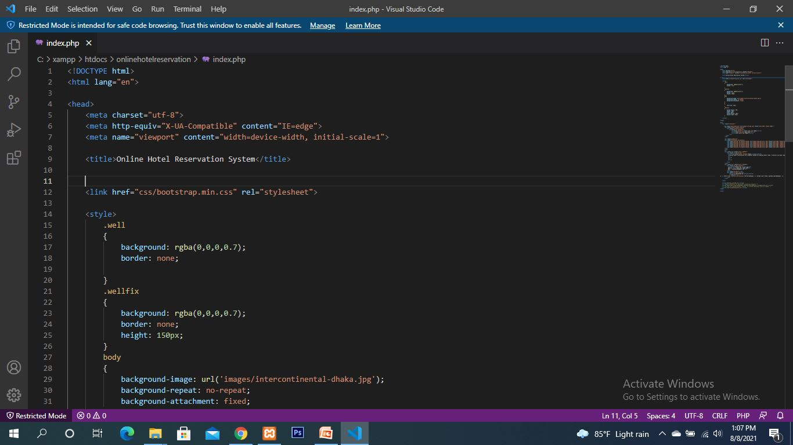
Sreenshot-1 of code

Slide 25
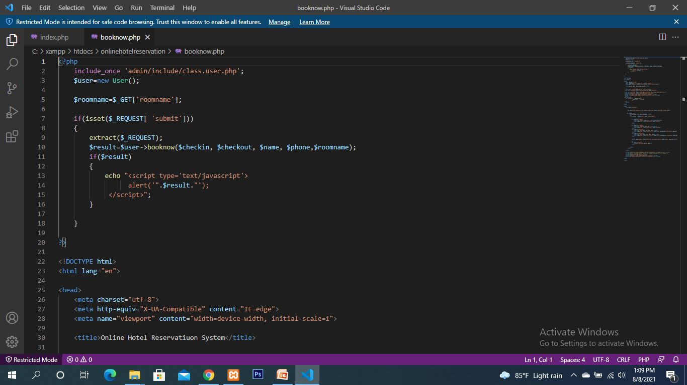
Sreenshot-2 of code

Slide 26
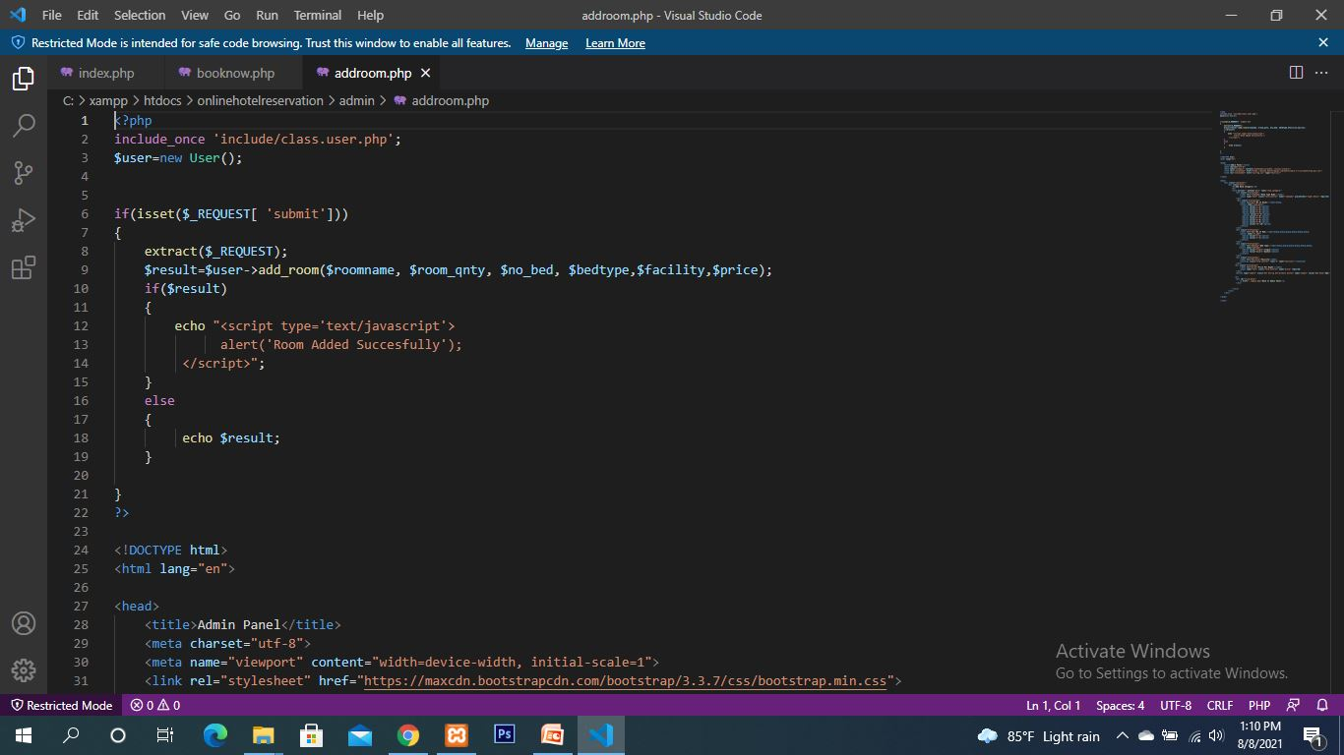
Sreenshot-2 of code

Slide 27


